Slide 1


Forest Fire Simulation Model
Group 3
Bradley Ochola 670346
Zakariya Muhumed 668596

Slide 2
INTRODUCTION
Forest fires pose significant ecological, economic, and social challenges.
Understanding the dynamics of forest fires is crucial for developing effective mitigation strategies and improving prediction accuracy.
One approach to simulate and analyse fire spread patterns is Cellular Automata (CA), a computational method that represents individual cells (trees) and their interactions within a grid.

Slide 3
Model Overview
The CA model developed in this study simulates a forest as a grid of cells (trees).
Each cell is characterized by its health status, location, and flammability.
The health status can be one of three states: healthy, burning, or burnt.
The model updates the forest state in discrete time steps, considering the influence of neighbouring cells and wind direction on fire spread.
The simulation consists of the following key components:
Forest Grid Creation
Fire Spread Rules
Environmental Factors

Slide 4
1.Forest Grid creation
The simulation begins with the creation of a forest grid. The grid size (number of rows and columns) is defined, and each cell represents a tree. Initially, most cells are set to the healthy state, with a small number of cells randomly selected to be in the burning state, representing the initial fire sources.
There are two
Moore Neighborhood
This approach considers all eight neighboring cells. A healthy tree will catch fire if two or more of its neighbors are burning.
Burning Duration
Trees in the burning state transition to burnt after a set number of time steps.

Slide 5
2. Fire Spread Rules:
A healthy tree catches fire if two or more neighbouring trees are burning.
This rule simulates the spread of fire from one tree to another.
A burning tree transitions to burnt after a specified duration.
This step ensures that once a tree has burned, it cannot catch fire again.
Wind direction can be incorporated to modify the probability of fire spread, affecting how fires propagate in specific directions.

Slide 6
3. Environmental Factors
Wind direction can be considered to simulate its effect on fire spread. The wind increases the likelihood of fire spreading in the downwind direction by modifying the fire propagation rules.
The wind factor adjusts the probability of fire spread based on its direction. For example, if the wind is blowing east, the fire spread probability is higher for cells east of a burning tree.

Slide 7
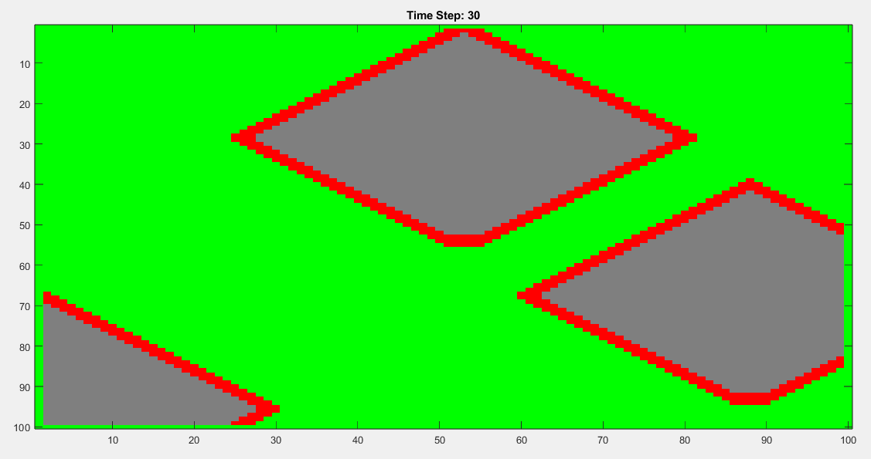
4.Visualisation
The imagesc function is used for visualization, with a colormap indicating healthy trees (green), burning trees (red), and burnt trees (grey).
The simulation runs for a specified number of time steps, updating and displaying the forest grid at each step.

Slide 8
Limitations
Future Improvements
The CA model has several limitations:
Simplified representation of fire dynamics.
Lack of consideration for varying vegetation types and topography.
Fixed flammability factor for all trees.
Future improvements to the CA model could include:
Incorporating varying vegetation types and topography.
Implementing more sophisticated rules for fire spread based on environmental conditions.
Introducing probabilistic elements to better simulate the stochastic nature of fire spread.

Slide 9
CONCLUSION
The simulation results demonstrate how a forest fire propagates over time.
The visual output shows the dynamic changes in the forest grid, highlighting the states of trees (healthy, burning, burnt) at each time step.
The inclusion of wind direction modifies the fire spread, making the simulation more realistic by showing the impact of environmental factors.

